Slide 1
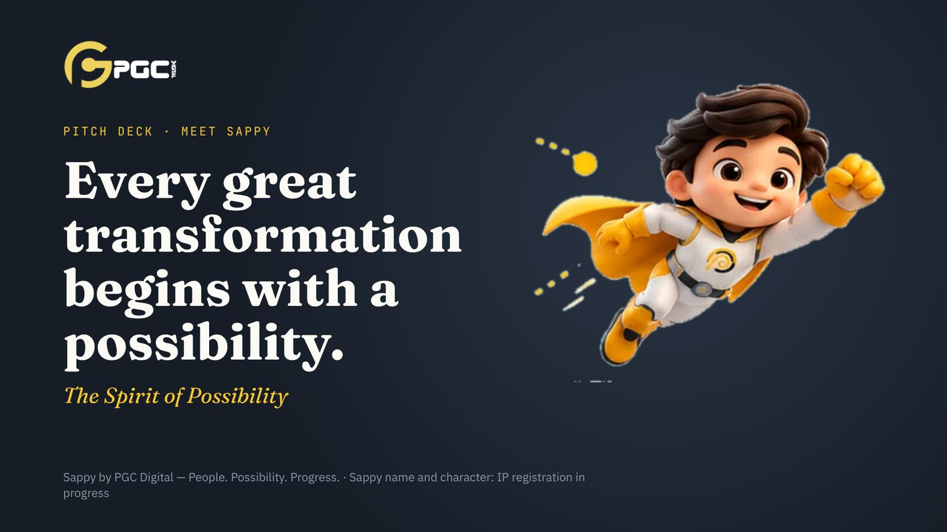
Notes:
Open slowly. Let the line land: every great transformation begins with a possibility. Then introduce Sappy as the character who carries that idea for PGC Digital.

Slide 2
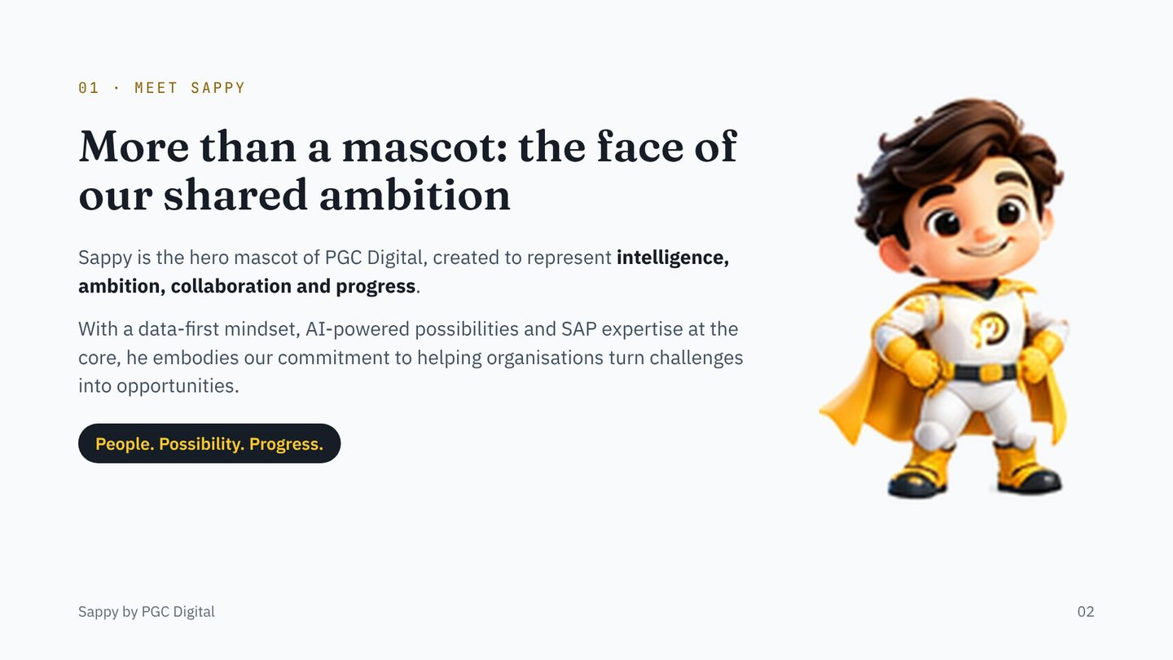
Notes:
Read the brand story lines word for word; they are the CEO’s approved text. Sappy is one character used everywhere: website, decks, documents, delivery and service.

Slide 3
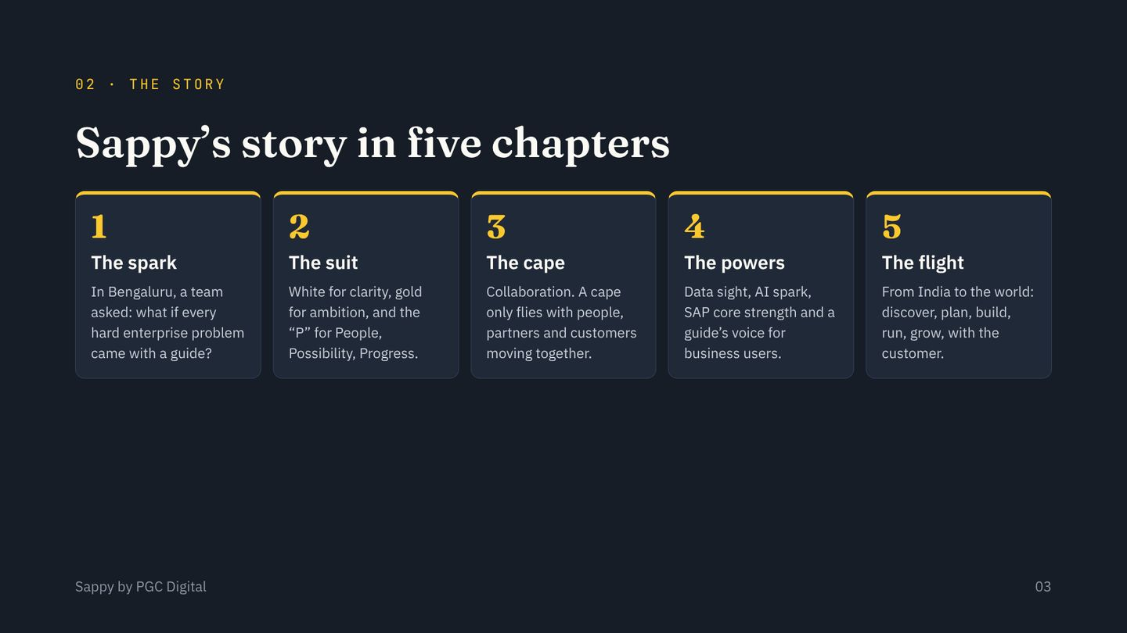
Notes:
Tell it as a story, one chapter per breath. The suit and the P on the chest are fixed parts of the identity and are never changed.

Slide 4
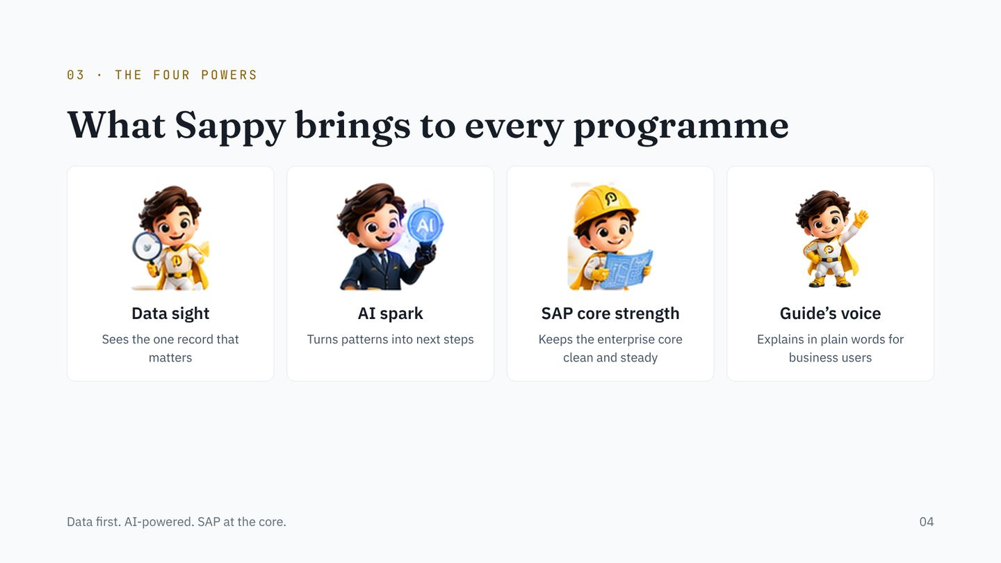
Notes:
The four powers map to our tagline: data first, AI-powered, SAP at the core, plus the guide’s voice that makes it usable for business people.

Slide 5
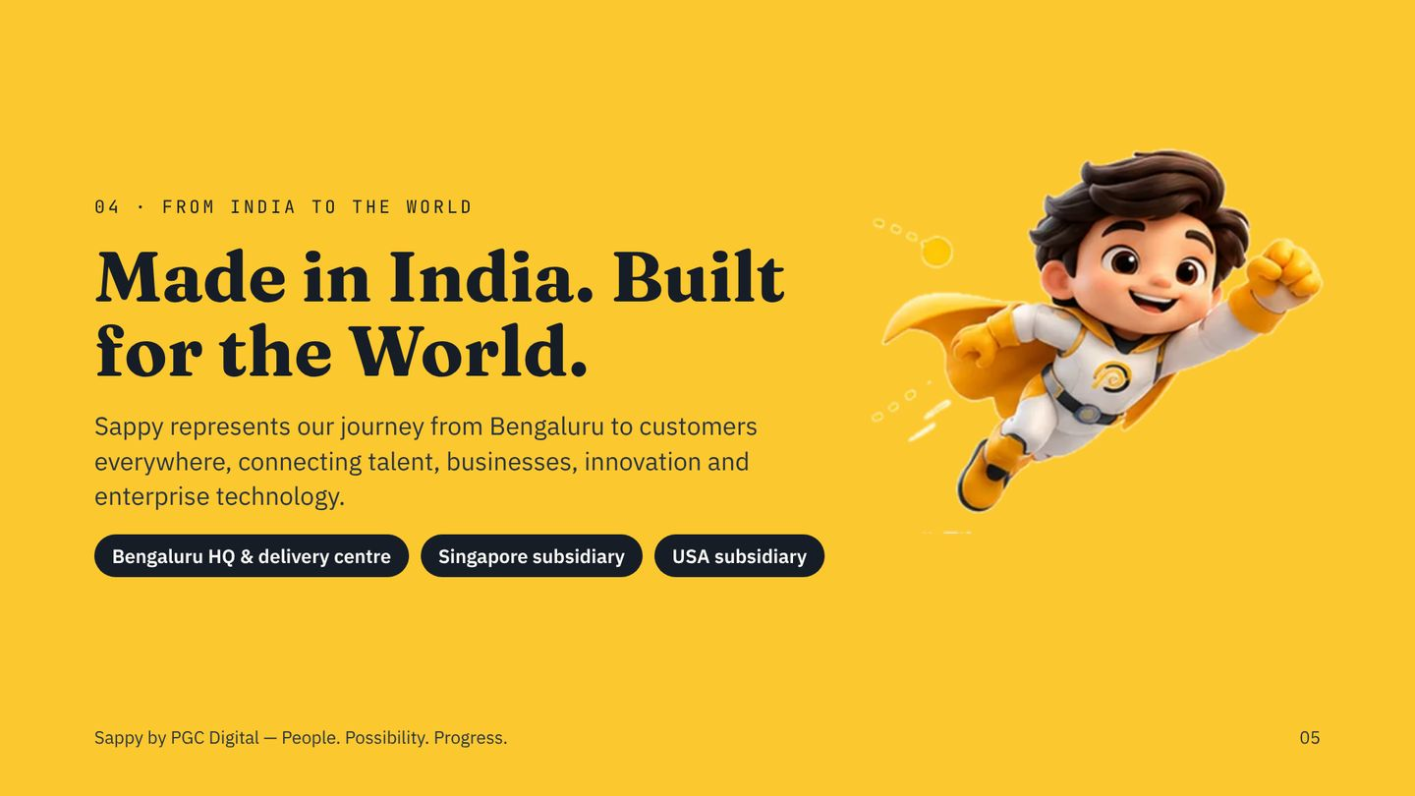
Notes:
Only the approved entities are shown: Bengaluru headquarters and principal delivery centre, and subsidiaries in Singapore and the USA, each 90 percent held.

Slide 6
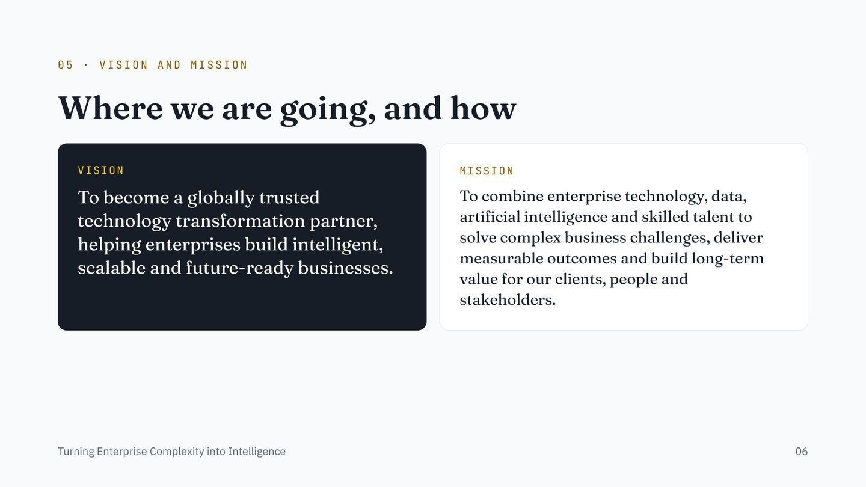
Notes:
Vision and mission are quoted verbatim from the approved About us page.

Slide 7
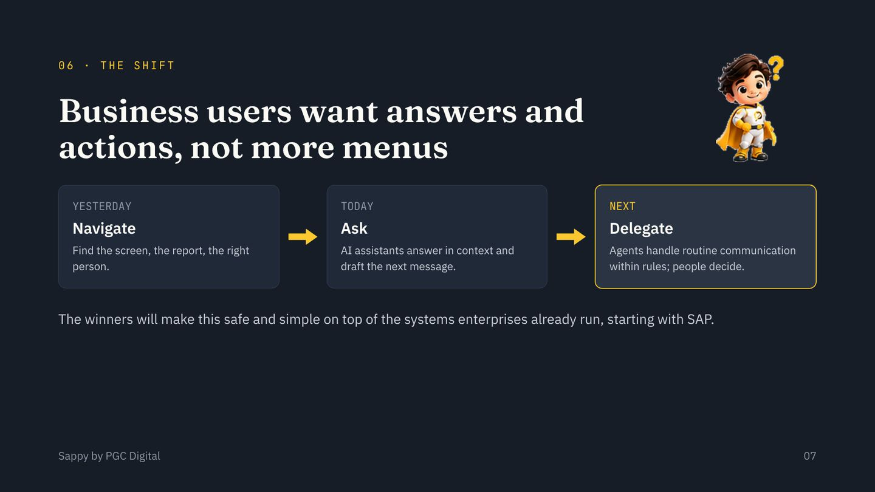
Notes:
This is a qualitative view of the market direction. If you want to add market-size figures, use only cited third-party research (Gartner, IDC, McKinsey) and name the source on the slide.

Slide 8
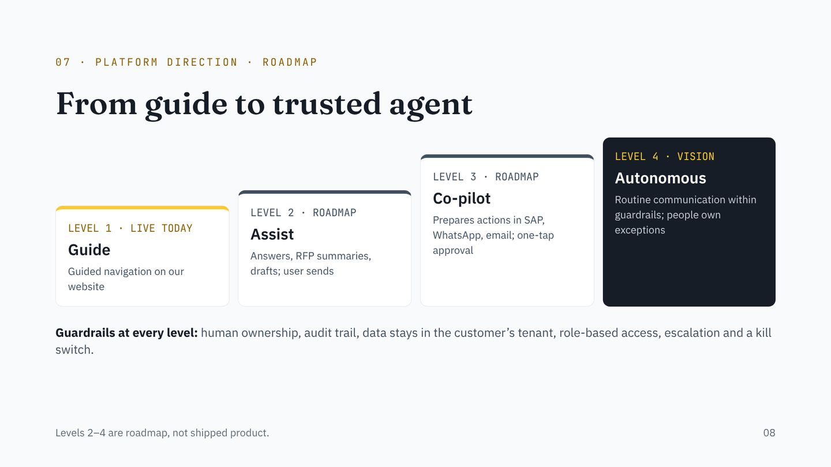
Notes:
Be precise about status: only level 1 is live. Levels 2 to 4 are our platform direction, built per customer inside their own SAP and communication systems.

Slide 9
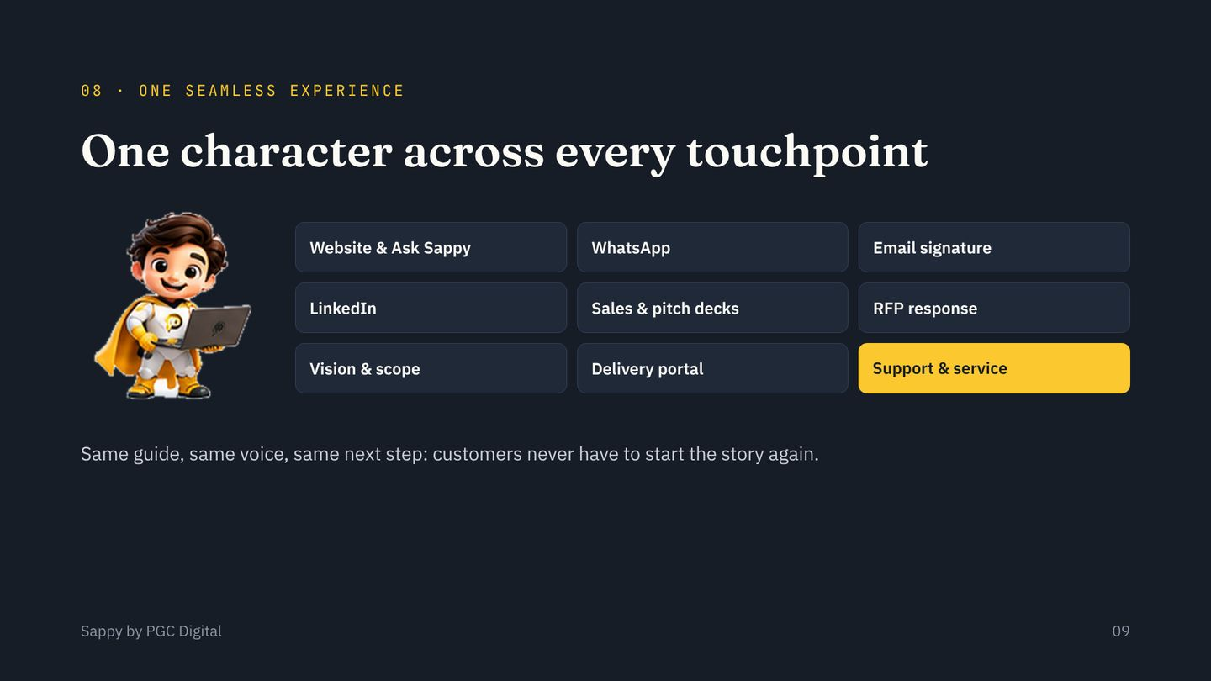
Notes:
Consistency is the moat: one recognisable character and one voice from first click to support ticket.

Slide 10
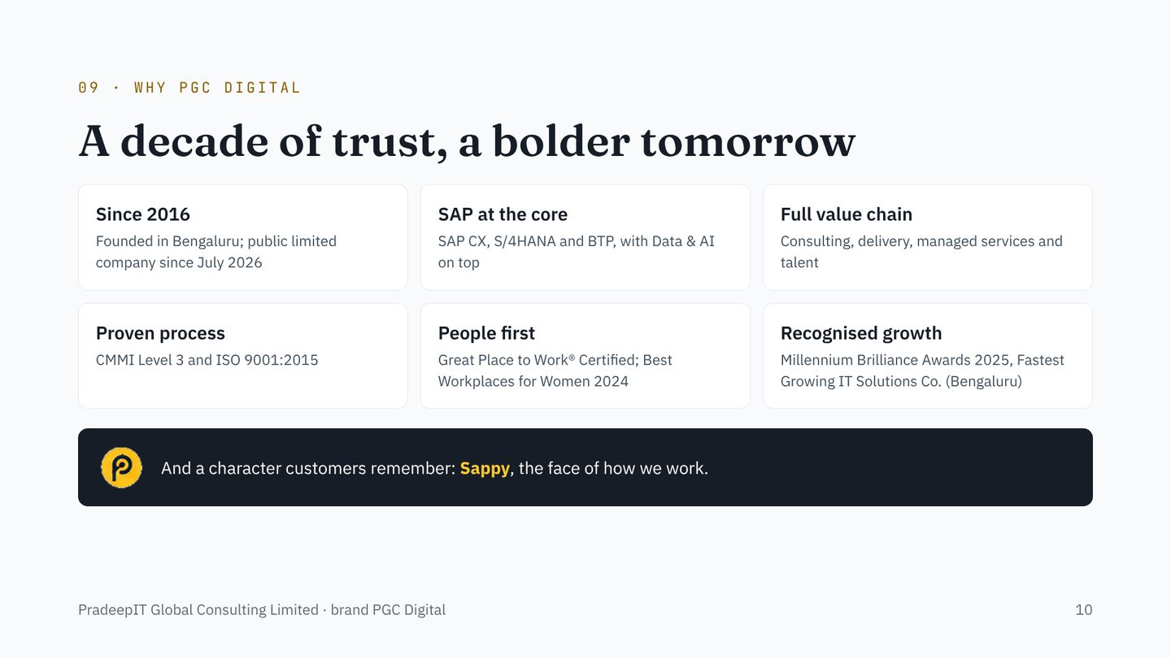
Notes:
Approved facts only. No revenue or financial figures are shown; add them only from approved, published numbers.

Slide 11
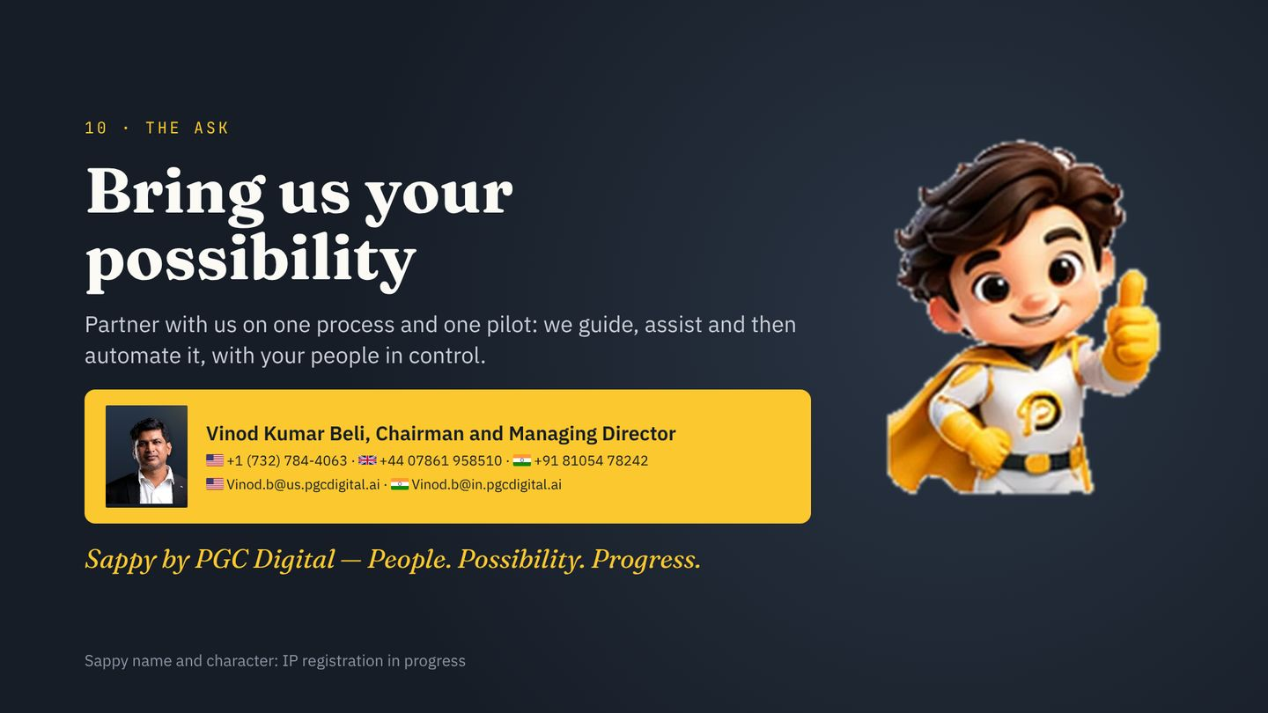
Notes:
Close with a concrete ask: one process, one pilot, one owner on the partner’s side. If this deck is used with investors, replace the ask with the approved offer details only.

