Slide 1

Notes:
Open with the line: every great transformation begins with a possibility. Introduce Sappy as the face of how PGC Digital works with customers: one guide from the first conversation to growth after go-live.

Slide 2
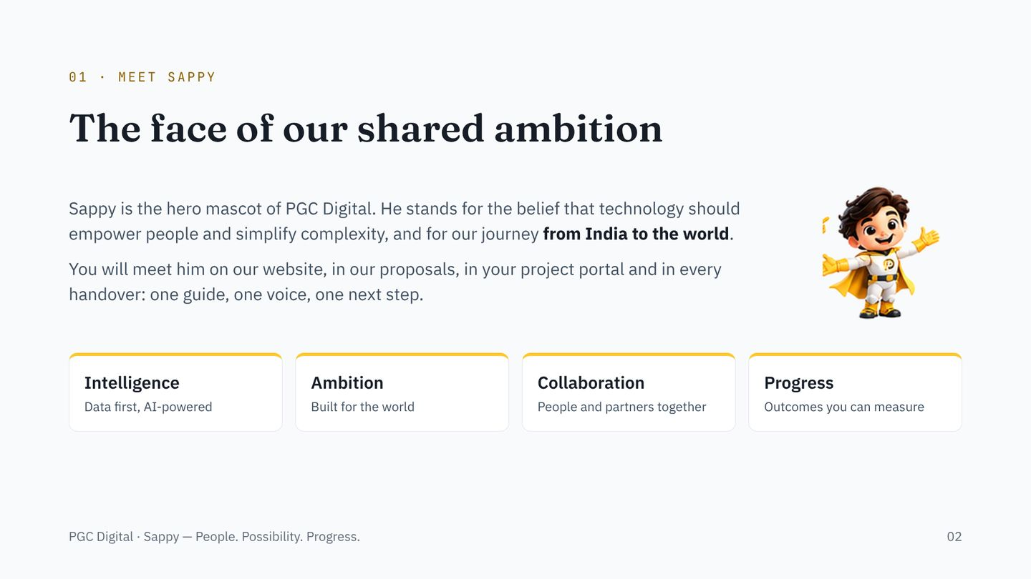
Notes:
Sappy stands for four values: intelligence, ambition, collaboration and progress. He is the same character on every touchpoint so customers recognise how we work before they read our name.

Slide 3
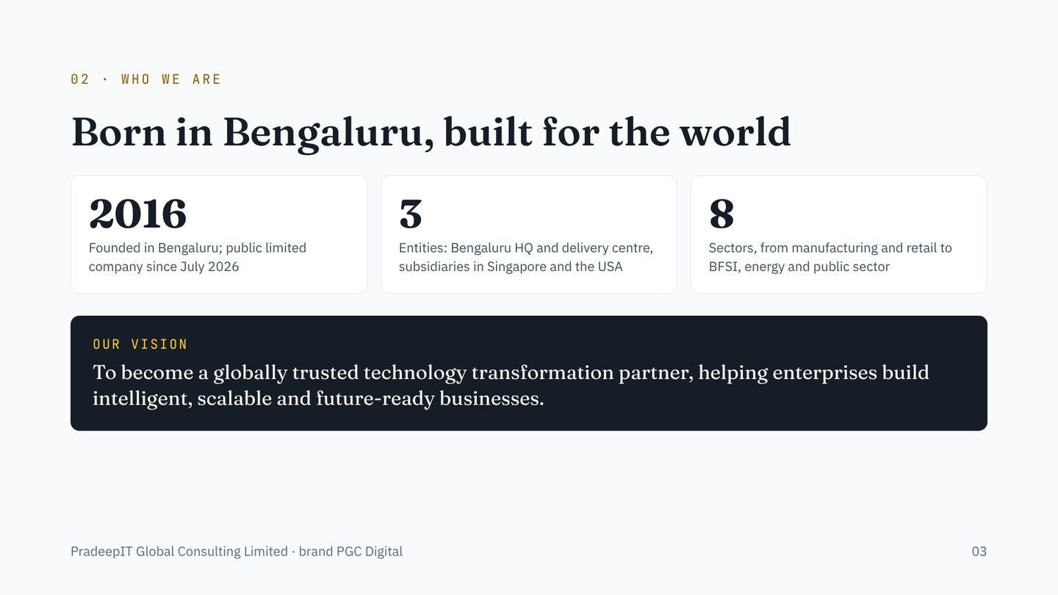
Notes:
PradeepIT Global Consulting Limited, brand PGC Digital. Founded 2016 in Bengaluru, converted to a public limited company on July 31, 2026. Headquarters and principal delivery centre at Brigade Gardens, Church Street, Bangalore; subsidiaries in Singapore and the USA, each 90 percent held.

Slide 4
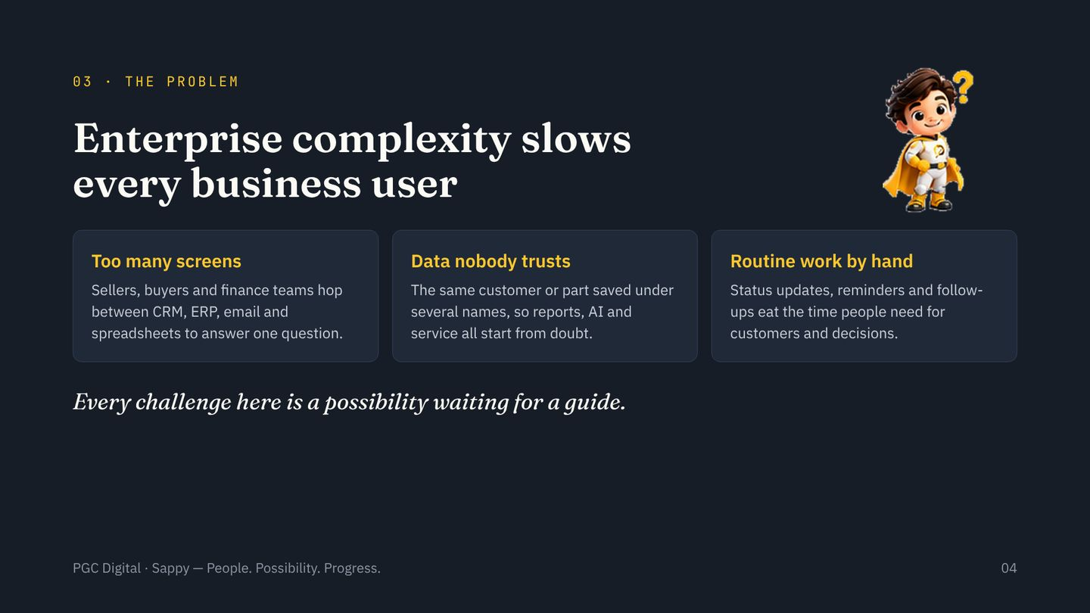
Notes:
Ask the customer which of the three hurts most today. Use their answer to pick which offer and which level of Sappy assistance to show next.

Slide 5
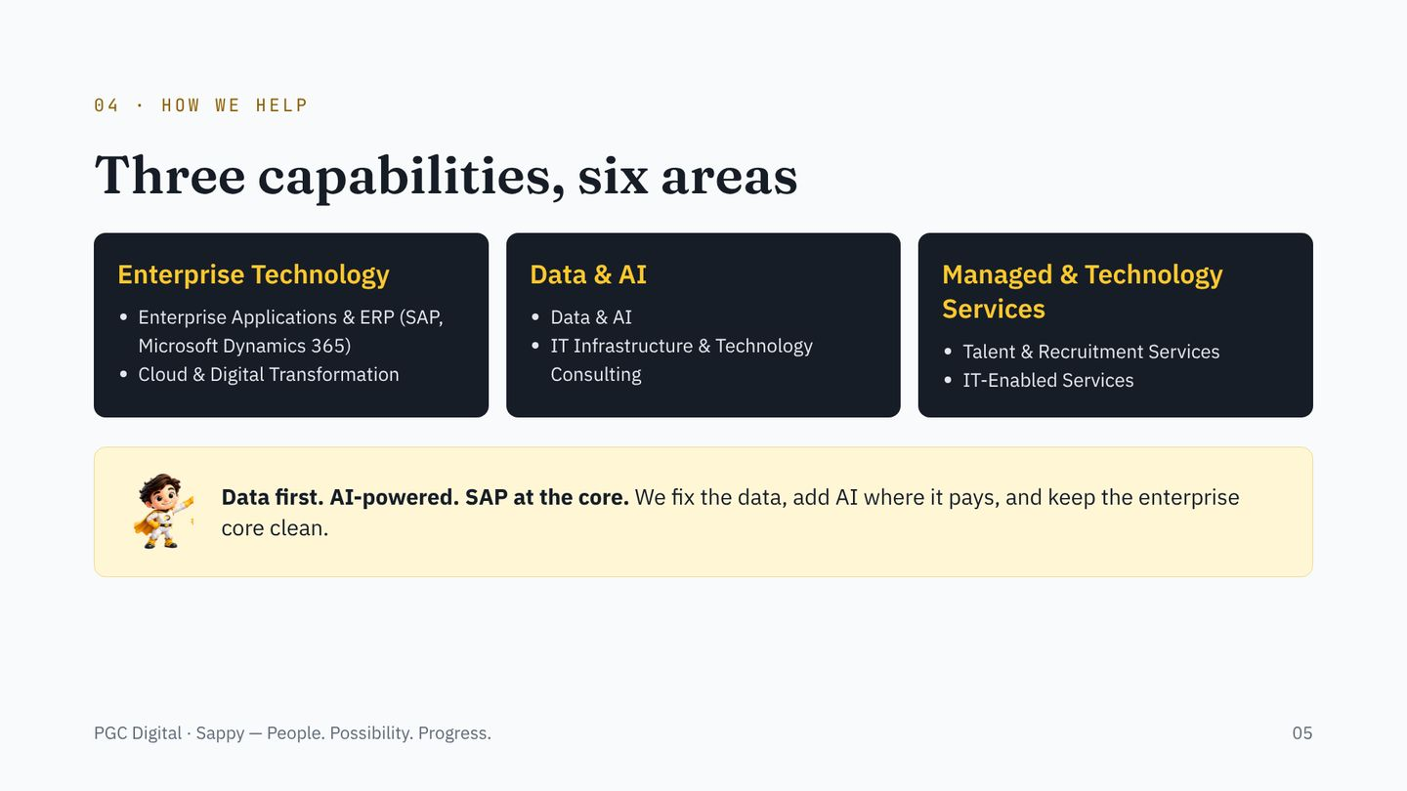
Notes:
Three capabilities and six business areas from the approved About us page. Grouping of the six areas under the three capabilities is for presentation; adjust if Brand prefers a different mapping.

Slide 6
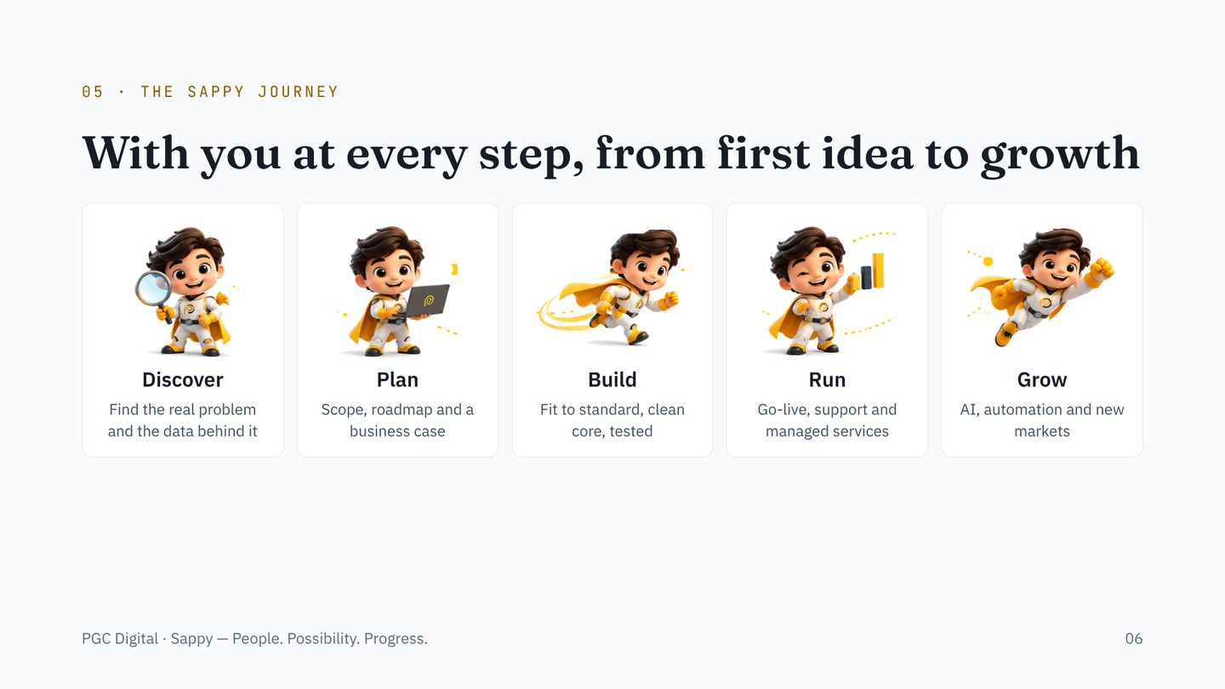
Notes:
The flight, chapter five of Sappy’s story: discover, plan, build, run, grow. Every proposal, plan and status report we send follows these five stages so the customer always knows where they are.

Slide 7
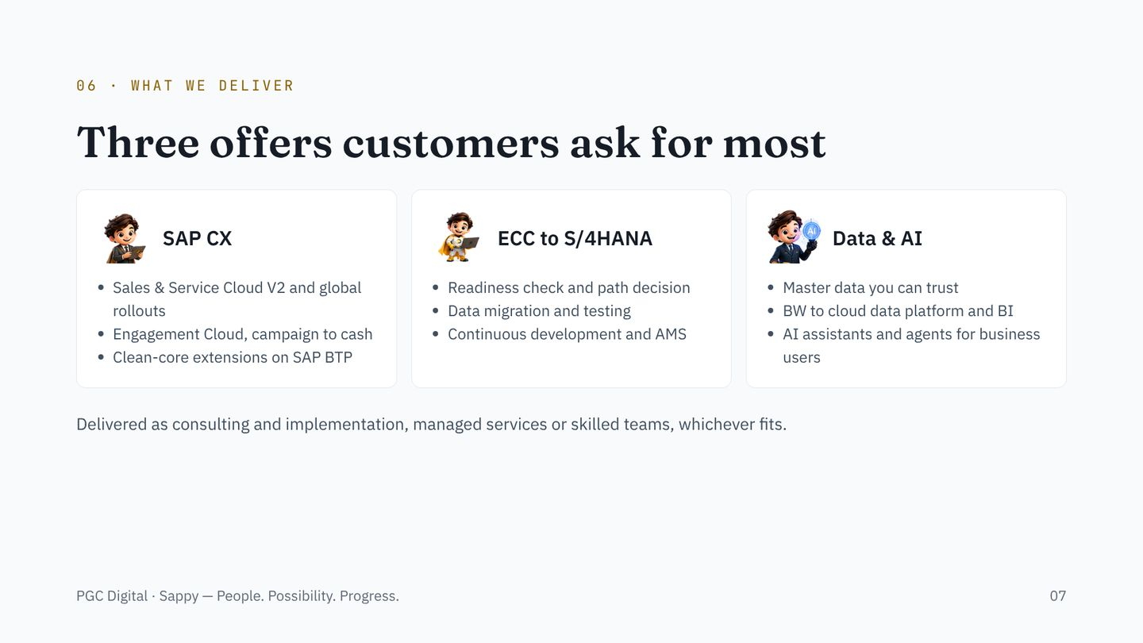
Notes:
Pick the one offer that matches the pain the customer named on the problem slide and go deep there. Detailed playbooks and guides for each are on the PGC Digital website.

Slide 8
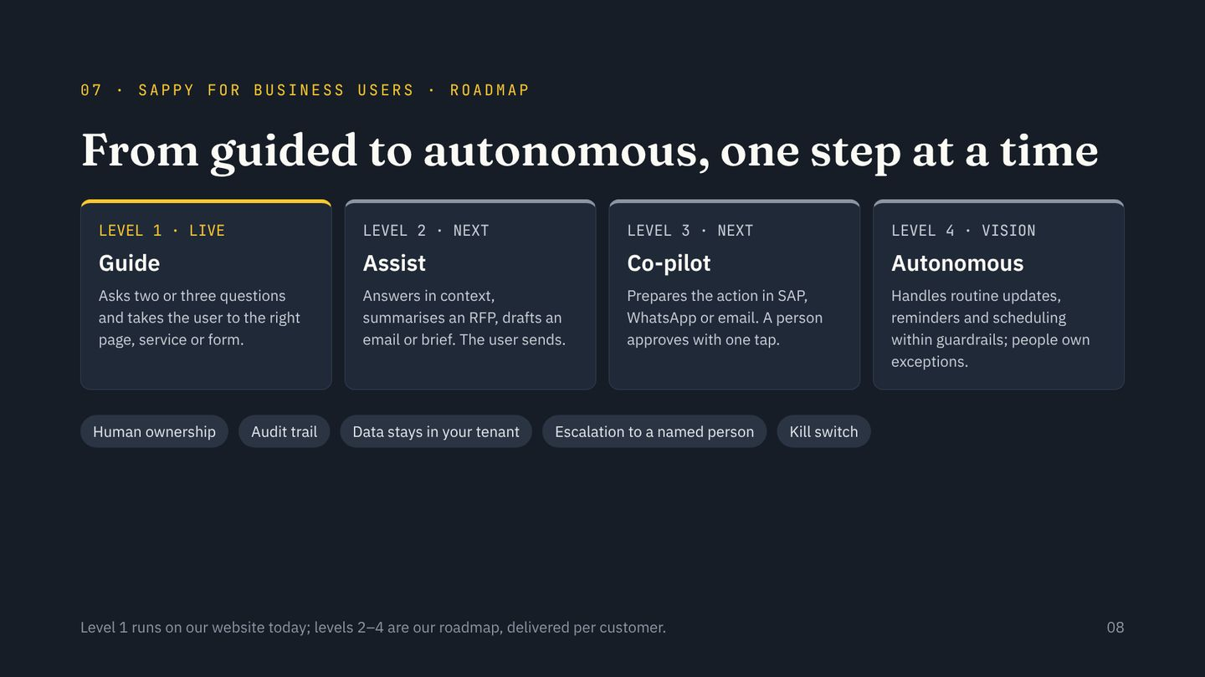
Notes:
Be clear: level 1, guided navigation with Ask Sappy, is live on our website. Levels 2 to 4 are roadmap and are built per customer inside their own systems. Anything commercial or unusual always stays with a person.

Slide 9
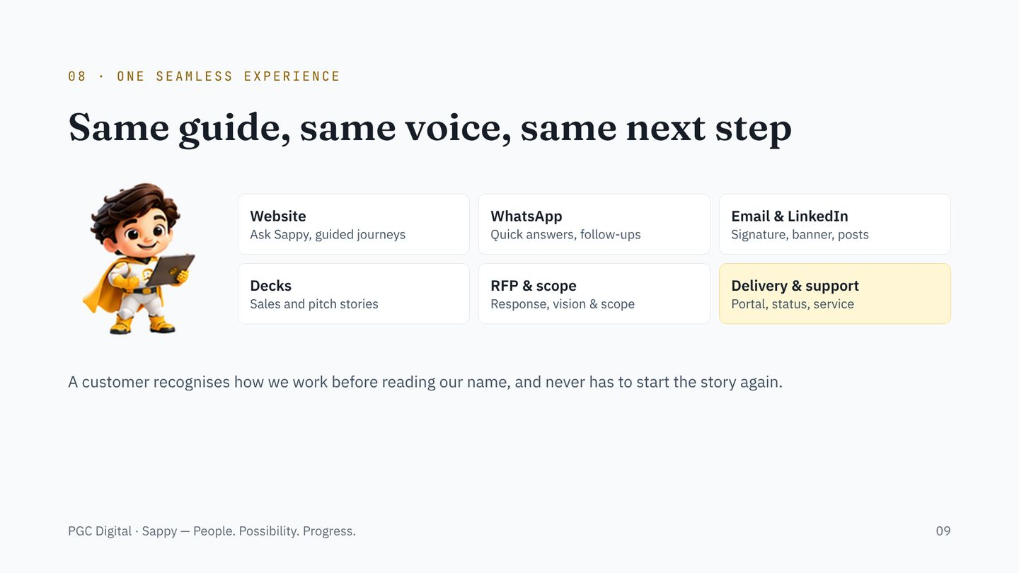
Notes:
Walk the touchpoints left to right, top to bottom. The point is continuity: what the customer told Sappy on the website shows up in the proposal, the scope and the support portal.

Slide 10
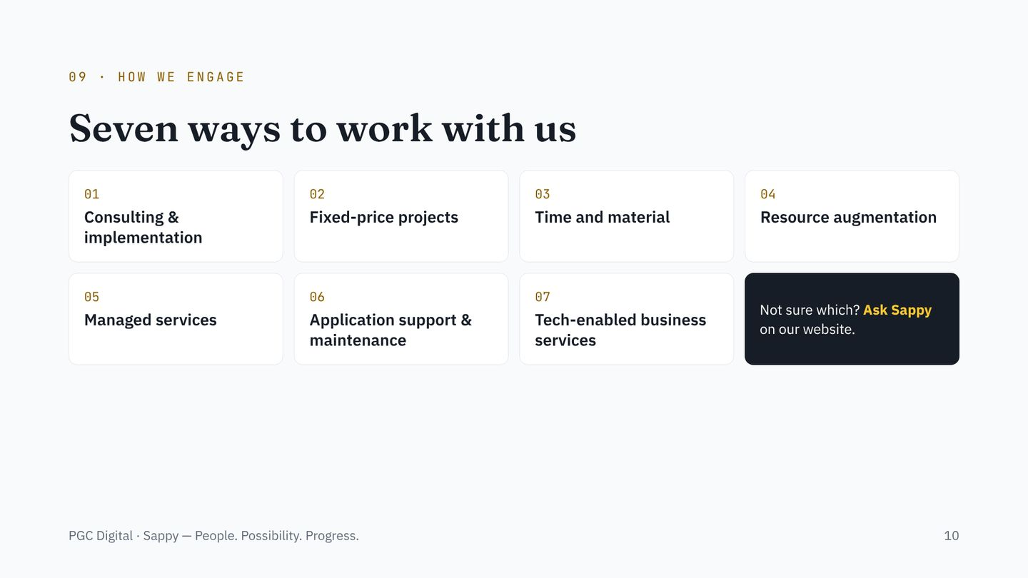
Notes:
The seven engagement models from our About us page. Recommend one based on how much ownership the customer wants to keep in house.

Slide 11
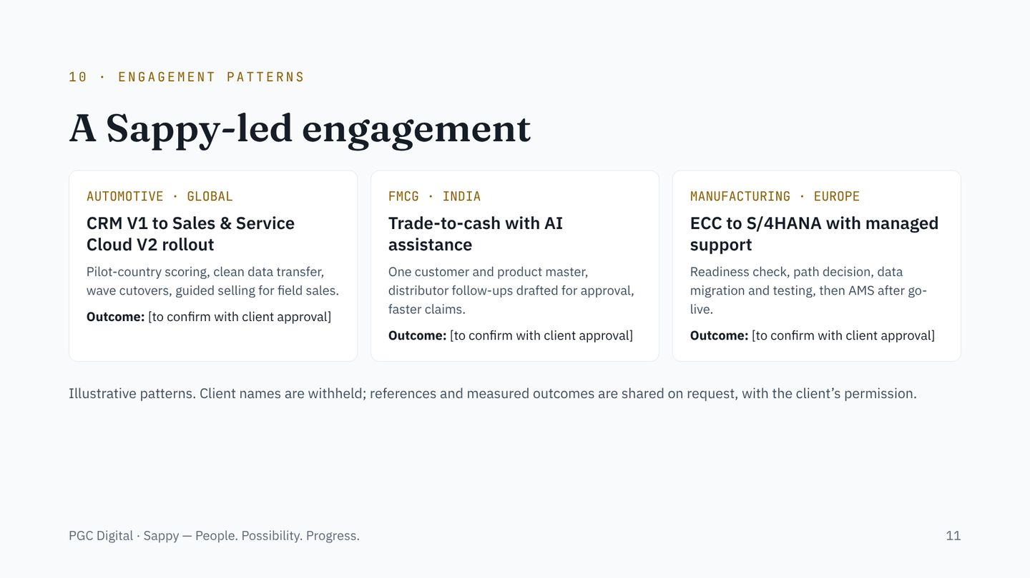
Notes:
These are illustrative engagement patterns, not named case studies. Replace the bracketed outcomes only with figures the client has approved. Automotive and FMCG are where our track record is strongest.

Slide 12
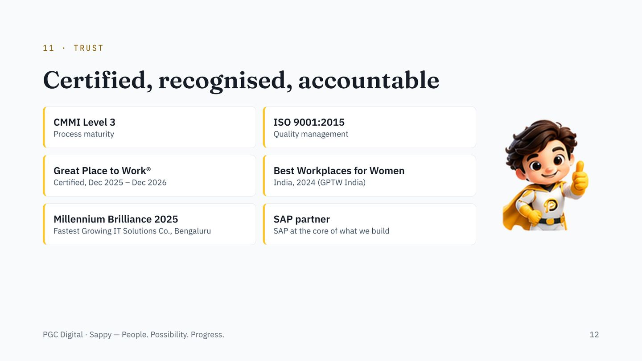
Notes:
Only the approved certifications and awards are shown. Do not mention ISO 27001 until it is confirmed on the About us page.

Slide 13
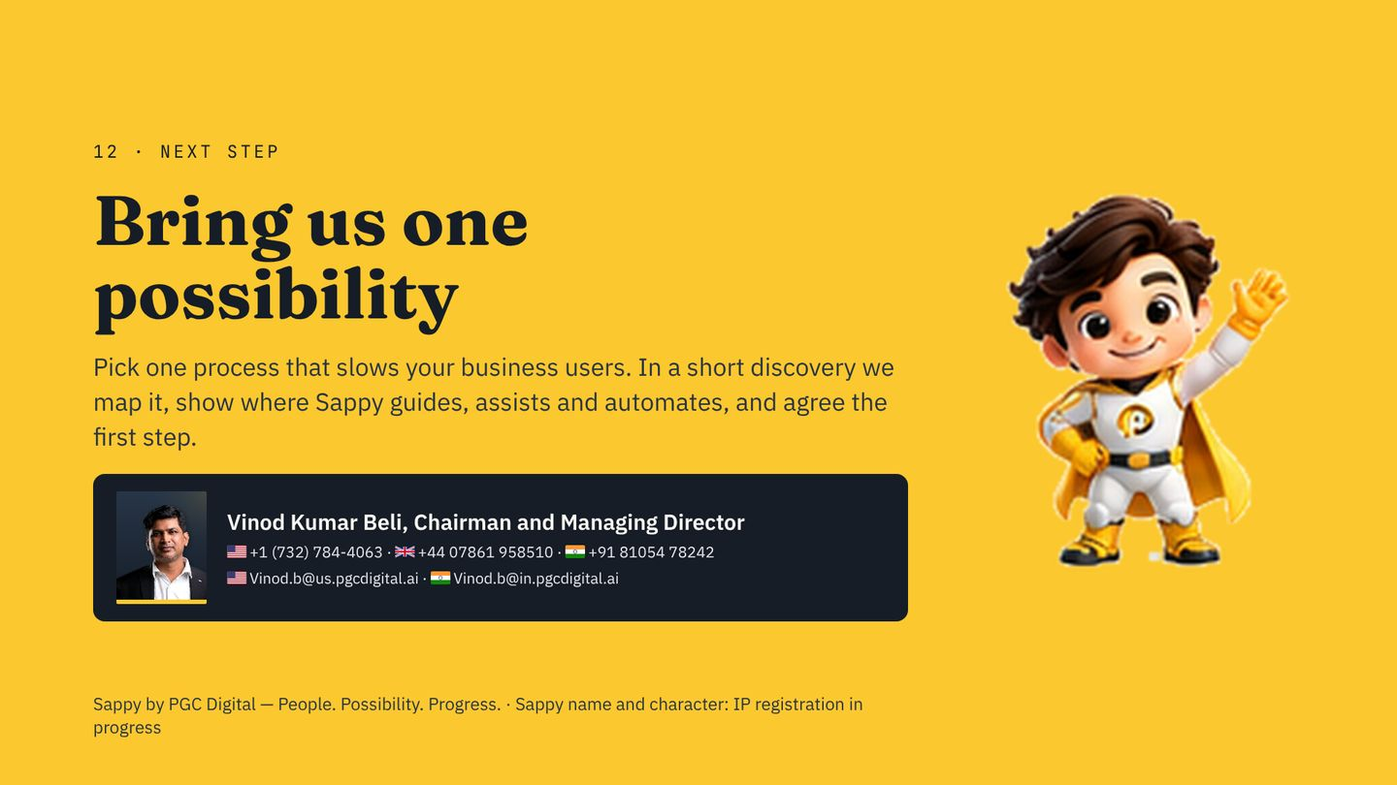
Notes:
Close by asking for one process and one owner on the customer side. Agree a date for the discovery session before you leave the room.

